Slide 1
Guitar String
Brandon Ho, Justin Hoey, Hannah Rajarao

Slide 2


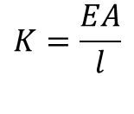
Plucked String
$$K=\frac{EA}{l}$$
K,R,M
$$x_{pluck}$$
$$L$$

Slide 3

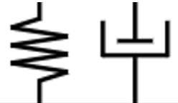

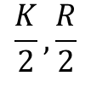
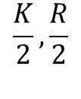


1 Node
$$M$$
$$\frac{K}{2},\frac{R}{2}$$
$$\frac{K}{2},\frac{R}{2}$$
$$x_{pluck}$$
$$L$$

Slide 4




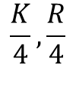






3 Nodes I
$$\frac{L}{4}$$
$$\frac{L}{4}$$
$$\frac{L}{4}$$
$$\frac{L}{4}$$
$$M/3$$
$$\frac{K}{4},\frac{R}{4}$$
$$\frac{K}{4},\frac{R}{4}$$
$$M/3$$
$$M/3$$
$$\frac{K}{4},\frac{R}{4}$$
$$\frac{K}{4},\frac{R}{4}$$

Slide 5




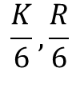





3 Nodes II
$$\frac{L}{6}$$
$$\frac{L}{6}$$
$$\frac{L}{6}$$
$$\frac{L}{6}$$
$$\frac{L}{6}$$
$$\frac{L}{6}$$
$$M/3$$
$$\frac{K}{3},\frac{R}{3}$$
$$\frac{K}{3},\frac{R}{3}$$
$$M/3$$
$$M/3$$
$$\frac{K}{6},\frac{R}{6}$$
$$\frac{K}{6},\frac{R}{6}$$

Slide 6






3 Nodes II
$$\frac{L}{5}$$
$$\frac{L}{5}$$
$$\frac{L}{10}$$
$$\frac{L}{5}$$
$$\frac{L}{5}$$
$$\frac{L}{10}$$
`
$$M/3$$
$$\frac{K}{3},\frac{R}{3}$$
$$\frac{K}{3},\frac{R}{3}$$
$$M/3$$
$$M/3$$
$$\frac{K}{6},\frac{R}{6}$$
$$\frac{K}{6},\frac{R}{6}$$

